Slide 1
Lecture 2
Math Foundations Team

Slide 2
Vector Spaces
We would like to shift focus from systems of linear equations and their solutions to vector spaces.
Vector spaces are structured spaces which contain vectors..
What do we mean by ”structure” here?

Slide 3
Groups
We already have some notion about the structure of a vector space, i.e adding two vectors returns a vector, multiplying a vector by a scalar also returns a vector.
To formalize these notions, we need the concept of a Group
A Group is a set G and an operation ⊗ : G × G → G defined on G. Then (G, ⊗) is called a group if the following properties hold:
Closure of G under ⊗: ∀x, y ∈ G, x ⊗ y ∈ G
Associativity: ∀x, y, z ∈ G, (x ⊗ y ) ⊗ z = x ⊗ (y ⊗ z )
Neutral or Identity element: ∋ e ∈ G, ∀x ∈ G x ⊗ e = x
Inverse element: ∀x ∈ G, ∋ y ∈ G, x ⊗ y = y ⊗ x = e
If in addition to all the above properties we have
∀x, y ∈ G, x ⊗ y = y ⊗ x then (G, ⊗) is an Abelian group

Slide 4
Some examples
(Z, +) where Z denotes the set of all integers is an Abelian group. We can see that all the aforementioned properties hold.
What about (N₀, +)? Here N₀ ={0,1,2,3….}.This is not a group since there is no inverse element for an arbitrary element in it.
(Z, .) where Z is the set of integers, and . is product. It has the identity element but there exist elements in it that don’t have an inverse.

Slide 5
Vector Spaces
We will now consider sets that are just like groups in terms of its properties with respect to an inner operation +, and also have an outer operation called . which denotes the multiplication of a vector x ∈ G by a scalar λ ∈ R.
The inner operation can be viewed as a form of addition while the outer operation can be viewed as a form of scaling.
A real-valued vector space is a set V = (V, +, .) with operations +, . such that + : V × V → V and . : R × V → V where (V, +) is an Abelian group, and the following properties hold:
Distributivity
associativity with respect to the outer operation.
there exists a neutral or identity element with respect to the outer operation.

Slide 6
Vector Spaces
Let us look at the properties of a Vector Space more carefully:
Distributivity: ∀λ ∈ R, x, y ∈ V, λ.(x + y) = λ.x + λ.y and
∀λ, ψ ∈ R, (λ + ψ).x = λ.x + ψ.x
Associativity with respect to the outer operation:
∀λ, ψ ∈ R, x ∈ V, λ.(ψ.x) = (λψ).x
Neutral element with respect to the outer operation: ∀x ∈ V,
1.x = x
The elements x ∈ V are called vectors.
The neutral element with respect to (V, +) is the zero vector 0 and the inner operation is called vector addition.

Slide 7
Examples of vector spaces
Consider the n-tuple R^{n} = {(x₁, x₂, …,x_{n}): x_{i} ∈ R, i = 1, 2, …n}
Define the vector addition + and . The scalar multiplication as follows:
(x₁, x₂, …,x_{n}) + (y₁, y₂, …,y_{n}) = (x₁+y₁, x₂+y₂, … x_{n}+y_{n})
For a ∈ R, a . (x₁, x₂, …,x_{n}) = (ax₁, ax₂, … ,ax_{n})
Then (R^{n}, +, .) is a vector space. (Verify)

Slide 8
Geometrical Interpretation of Vector addition and scalar multiplication in R²
Addition in Vector Space R²
Scalar Multiplication in
Vector Space R²

Slide 9
Why do we study Vector Spaces? (In the context of ML)
Without understanding vectors one can not proceed to learn ML.
Vectors are used in different stages of the ML model.
Input: As machines can not read text or look at images, they need input to be transformed or encoded into vectors of numbers so that we can train and deploy the model.
Model: The goal of most ML projects is to create a model that performs some function. It could be classifying text, or predicting house prices, or identifying sentiment. In deep learning models, this is achieved via a neural network where the neural network layers use linear algebra (like matrix and vector multiplication) to tune your parameters. This is where the mathematical definition of vectors is relevant for ML.

Slide 10
Output: The output of the ML model can be a range of different entities depending on our goal. If we’re predicting house prices, the output will be a number. If we’re classifying images, the output will be a category of image.
NLP models like the Universal Sentence Encoder (USE) accept text and then output a vector (called an embedding) representing the sentence. One can then use these vectors to perform a range of operations, or as an input into another model.
The operations you can perform are clustering similar sentences together in a vector space, or
finding similarity between different sentences using operations like cosine similarity.
Understanding these operations will help us know how to work with models that output vectors
like these NLP models.

Slide 11
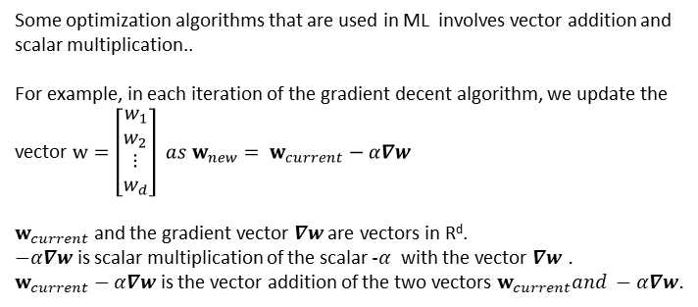
Vectors in some optimization algorithms
Some optimization algorithms that are used in ML involves vector addition and scalar multiplication..
For example, in each iteration of the gradient decent algorithm, we update the vector $w=\left[\begin{matrix}\begin{matrix}w_{1} \\ w_{2}\end{matrix} \\ ⋮ \\ w_{d}\end{matrix}\right] as w_{new}= w_{current}−α∇w$
$w_{current}$ and the gradient vector $∇w$ are vectors in R^{d}.
$−α∇w$ is scalar multiplication of the scalar $−α$with the vector $∇w$ .
$w_{current}−α∇w$ is the vector addition of the two vectors $w_{current}and −α∇w.$

Slide 12
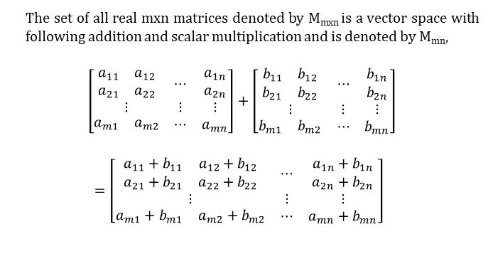
Matrices forms a vector space
The set of all real mxn matrices denoted by M_{mxn} is a vector space with following addition and scalar multiplication and is denoted by M_{mn},
$$\left[\begin{matrix}\begin{matrix}\begin{matrix}a_{11} \\ a_{21}\end{matrix} & \begin{matrix}a_{12} \\ a_{22}\end{matrix}\end{matrix} & ⋯ & \begin{matrix}a_{1n} \\ a_{2n}\end{matrix} \\ ⋮ & ⋮ & ⋮ \\ \begin{matrix}a_{m1} & a_{m2}\end{matrix} & ⋯ & a_{mn}\end{matrix}\right]+\left[\begin{matrix}\begin{matrix}\begin{matrix}b_{11} \\ b_{21}\end{matrix} & \begin{matrix}b_{12} \\ b_{22}\end{matrix}\end{matrix} & ⋯ & \begin{matrix}b_{1n} \\ b_{2n}\end{matrix} \\ ⋮ & ⋮ & ⋮ \\ \begin{matrix}b_{m1} & b_{m2}\end{matrix} & ⋯ & b_{mn}\end{matrix}\right]$$
$$=\left[\begin{matrix}\begin{matrix}\begin{matrix}a_{11}+b_{11} \\ a_{21}+b_{21}\end{matrix} & \begin{matrix}a_{12}+b_{12} \\ a_{22}+b_{22}\end{matrix}\end{matrix} & ⋯ & \begin{matrix}a_{1n}+b_{1n} \\ a_{2n}+b_{2n}\end{matrix} \\ ⋮ & ⋮ & ⋮ \\ \begin{matrix}a_{m1}+b_{m1} & a_{m2}+b_{m2}\end{matrix} & ⋯ & a_{mn}+b_{mn}\end{matrix}\right]$$

Slide 13
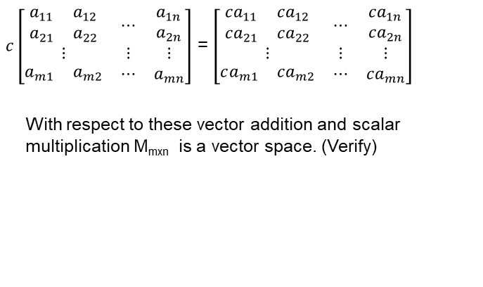
Examples
$c\left[\begin{matrix}\begin{matrix}\begin{matrix}a_{11} \\ a_{21}\end{matrix} & \begin{matrix}a_{12} \\ a_{22}\end{matrix}\end{matrix} & ⋯ & \begin{matrix}a_{1n} \\ a_{2n}\end{matrix} \\ ⋮ & ⋮ & ⋮ \\ \begin{matrix}a_{m1} & a_{m2}\end{matrix} & ⋯ & a_{mn}\end{matrix}\right]$ = $\left[\begin{matrix}\begin{matrix}\begin{matrix}{ca}_{11} \\ {ca}_{21}\end{matrix} & \begin{matrix}{ca}_{12} \\ {ca}_{22}\end{matrix}\end{matrix} & ⋯ & \begin{matrix}{ca}_{1n} \\ ca_{2n}\end{matrix} \\ ⋮ & ⋮ & ⋮ \\ \begin{matrix}ca_{m1} & {ca}_{m2}\end{matrix} & ⋯ & {ca}_{mn}\end{matrix}\right]$
With respect to these vector addition and scalar multiplication M_{mxn} is a vector space. (Verify)

Slide 14
Vector subspaces
Let V = (V, +, .) be a vector space and let U ⊆ V, U ≠ Φ. then U = (U , +, .) is called a vector subspace of V if U is a vector space with the vector space operations + and . restricted to U × U and R × U.
We use the notation U ⊆ V to denote that U is a vector subspace of V .
If U ⊆ V and V is a vector space, then U naturally inherits many properties directly from V because they hold for all x
∈ V , and in particular for all x ∈ U ⊆ V . These properties include the Abelian group property, associativity, distributivity and the neutral element.

Slide 15
Establishing vector subspaces
How do we show if (U , +, .) is subspace of V ? We need to show that
U ≠ Φ
Closure of U with respect to the outer and inner operations,
i.e ∀λ ∈ R, ∀x ∈ U , λx ∈ U and ∀x , y ∈ U , x + y ∈ U.
Closure properties will also ensure that for each element additive identity and inverse of each element exist in U

Slide 16
Examples
Let V = R² and U be the y -axis. . Is U = (U , +, .) a subspace of V = (V, +, .)?
Answer: Yes, because the addition of any two vectors on the y -axis remains on the y -axis so closure with respect to the addition operation is satisfied. Also any vector on the y -axis when scaled by any real number (including 0) will yield a vector on y -axis.
What about when we shift the y -axis one unit to the right, i.e U = {x = 1}?
Answer: We no longer have a vector subspace since scaling with respect to the outer operation does not have the closure property.

Slide 17
More examples
What about the subset of R² that represents a square region around the origin , i.e −1 ≤ x ≤ 1, −1 ≤ y ≤ 1? This is again not a subspace. Why?
Let A be a fixed mxn matrix.The set of solutions to the linear homogenous system of equations Ax = 0 is a vector subspace of R^{n}.
This space is called null space of A.
Why is this a vector subspace?

Slide 18
Linear combination and linear independence
We know that we can stay in a vector space by adding vectors belonging to the space, and scaling them?
We are now interested in a different question → can we come up with a set of vectors such that every vector in the vector space can be represented as a sum of these vectors with scaling as necessary?
The answer is yes. A set of vectors capable of representing all vectors in a vector space is called a basis.
To explore the question of finding a basis, we need to learn the concepts of linear combination and linear independence.

Slide 19
Linear combination
Consider a vector space V and a set of vectors x₁, x₂, . . .
x_{k} ∈ V . Then an element v ∈ V that is of the form v = λ₁x₁ + λ₂x₂ . . . + λ_{k} x_{k} is a linear combination of the vectors x₁, x₂, . . . x_{k} .
Note that the 0 can be written trivially as a linear combination of the given k vectors x_{i} s. We are however interested in
non-trivial linear combinations of vectors to get the 0-vector.

Slide 20
Examples of Linear Combinations
Example 1. Let S = {[1, 0, 1], [1, 1,0], [1, 1, 1]}
Then the vector [1, -2, 3] is linear combination of the elements of S.
Since [1, -2, 3] = 3[1, 0, 1] + (-2) [1, 1,0].
Example 2 : Let S = {[1, 0, 0], [0,1, 0], [ 1, 2, 0]} Then the vector [1, 1, 1] is not a linear combination of elements of S. But [-1, 4, 0] is a linear combination of elements of S.
How do you find a, b, c such that
[-1, 4, 0] = a[1, 0, 0] + b[0,1, 0] + c[ 1, 2, 0]
Simply by observation one can see that a=-1, b = 4, and c = 0.
.

Slide 21
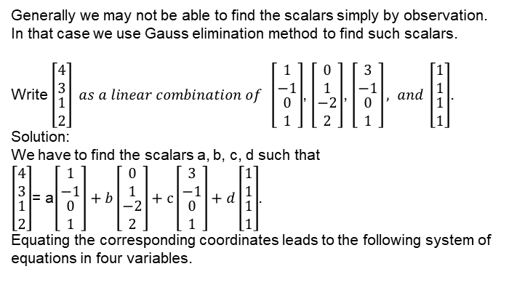
Gauss Elimination Method to fine the scalars in Linear combination
Generally we may not be able to find the scalars simply by observation. In that case we use Gauss elimination method to find such scalars.
Write $\left[\begin{matrix}\begin{matrix}4 \\ 3\end{matrix} \\ \begin{matrix}1 \\ 2\end{matrix}\end{matrix}\right] as a linear combination of \left[\begin{matrix}\begin{matrix}1 \\ −1\end{matrix} \\ \begin{matrix}0 \\ 1\end{matrix}\end{matrix}\right]$, $\left[\begin{matrix}\begin{matrix}0 \\ 1\end{matrix} \\ \begin{matrix}−2 \\ 2\end{matrix}\end{matrix}\right]$, $\left[\begin{matrix}\begin{matrix}3 \\ −1\end{matrix} \\ \begin{matrix}0 \\ 1\end{matrix}\end{matrix}\right], and \left[\begin{matrix}\begin{matrix}1 \\ 1\end{matrix} \\ \begin{matrix}1 \\ 1\end{matrix}\end{matrix}\right]$.
Solution:
We have to find the scalars a, b, c, d such that
$\left[\begin{matrix}\begin{matrix}4 \\ 3\end{matrix} \\ \begin{matrix}1 \\ 2\end{matrix}\end{matrix}\right]$= a$\left[\begin{matrix}\begin{matrix}1 \\ −1\end{matrix} \\ \begin{matrix}0 \\ 1\end{matrix}\end{matrix}\right]+b\left[\begin{matrix}\begin{matrix}0 \\ 1\end{matrix} \\ \begin{matrix}−2 \\ 2\end{matrix}\end{matrix}\right]+c\left[\begin{matrix}\begin{matrix}3 \\ −1\end{matrix} \\ \begin{matrix}0 \\ 1\end{matrix}\end{matrix}\right]+d\left[\begin{matrix}\begin{matrix}1 \\ 1\end{matrix} \\ \begin{matrix}1 \\ 1\end{matrix}\end{matrix}\right]$.
Equating the corresponding coordinates leads to the following system of equations in four variables.

Slide 22
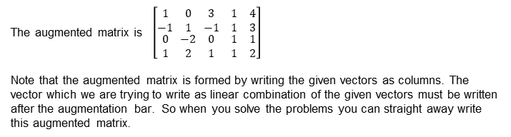

Example (Ctd)
$a+3c+d=4$ $−a+b−c+d=3$
$$−2b+d=1$$
$$a+2b+c+d=2$$
The augmented matrix is $\left[\begin{matrix}\begin{matrix}1 & 0 & 3 \\ −1 & 1 & −1\end{matrix} & \begin{matrix}1 & 4 \\ 1 & 3\end{matrix} \\ \begin{matrix}0 & −2 & 0 \\ 1 & 2 & 1\end{matrix} & \begin{matrix}1 & 1 \\ 1 & 2\end{matrix}\end{matrix}\right]$
Note that the augmented matrix is formed by writing the given vectors as columns. The vector which we are trying to write as linear combination of the given vectors must be written after the augmentation bar. So when you solve the problems you can straight away write this augmented matrix.

Slide 23
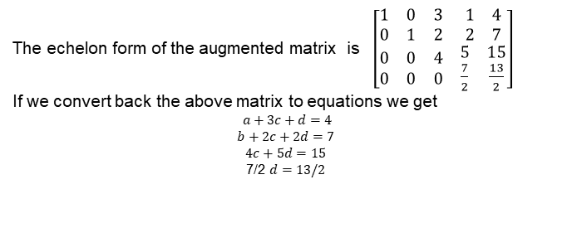
Example (Ctd)
The echelon form of the augmented matrix is $\left[\begin{matrix}\begin{matrix}1 & 0 & 3 \\ 0 & 1 & 2\end{matrix} & \begin{matrix}1 & 4 \\ 2 & 7\end{matrix} \\ \begin{matrix}0 & 0 & 4 \\ 0 & 0 & 0\end{matrix} & \begin{matrix}5 & 15 \\ \frac{7}{2} & \frac{13}{2}\end{matrix}\end{matrix}\right]$
If we convert back the above matrix to equations we get
$a+3c+d=4$
$$b+2c+2d=7$$
$$4c+5d=15$$
7/2 $d=13/2$
By back substitution we get d = 13/7, c = 10/7, b = 3/7, and a = -15/7.

Slide 24
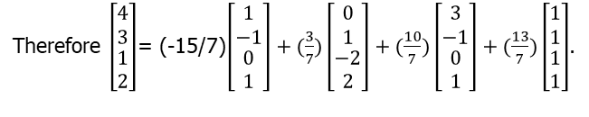
Example ctd
Therefore $\left[\begin{matrix}\begin{matrix}4 \\ 3\end{matrix} \\ \begin{matrix}1 \\ 2\end{matrix}\end{matrix}\right]$= (-15/7)$\left[\begin{matrix}\begin{matrix}1 \\ −1\end{matrix} \\ \begin{matrix}0 \\ 1\end{matrix}\end{matrix}\right]+(\frac{3}{7})\left[\begin{matrix}\begin{matrix}0 \\ 1\end{matrix} \\ \begin{matrix}−2 \\ 2\end{matrix}\end{matrix}\right]+(\frac{10}{7})\left[\begin{matrix}\begin{matrix}3 \\ −1\end{matrix} \\ \begin{matrix}0 \\ 1\end{matrix}\end{matrix}\right]+(\frac{13}{7})\left[\begin{matrix}\begin{matrix}1 \\ 1\end{matrix} \\ \begin{matrix}1 \\ 1\end{matrix}\end{matrix}\right]$.
Now we ask an important question:
Why echelon form or reduced echelon form of an augmented matrix of a system of linear equations does not alter the solutions of the linear system?
Note that this fact (answer to the question) is used in solving the above problem.
We obtain echelon form or reduced echelon form of an augmented matrix by applying elementary row operations.

Slide 25
Elementary Row operations do not alter the solution
Note that the elementary operations that correspond to elementary row operations do not change the solutions of the system.
More over the elementary row operations are reversible.

Slide 26
Why elementary operations are reversible
Inverse operations
1. Interchange the same two rows again
2. If the non zero constant is c then again multiply the same row by 1/c.
3. If row R_{j} is replaced by R_{j}+aR_{i} then the inverse operation is R_{j}is replaced by R_{j}+(-a)R_{i}

Slide 27
Spanning a Vector Space
Example 1. (1,0,0), (0,1,0), (0,0,1) spans R³
Example 2. . (1,0,0), (0,1,0), (1,1,1) spans R³, since (x, y, z) = (x-z)(1,0,0) +
(y-z)(0,1,0)+z(1,1,1)
Example 3.
Example 4
Is it always true that span of any n vectors of V a subspace of V ?

Slide 28
Spanning a Vector Space
Theorem : If v₁, v₂, …v_{n} are vectors in a vector space V and let U be the set of all vectors in V which are linear combinations of v₁, v₂,… v_{n}. Then U is a subspace of V.
Note : U is said to be generated by v₁, v₂,… v_{n} and is denoted by span{v₁, v₂, … v_{n}}.
Example : R³ = span {(1,0,0), (0,1,0), (0,0,1)}
$U=\left\{\left[\begin{matrix}1 & 0 \\ 0 & 0\end{matrix}\right],\left[\begin{matrix}0 & 0 \\ 0 & 1\end{matrix}\right]\right\}$ is a subspace of M₂₂ but not equal to M_{22.}

Slide 29
Linear dependence and independence
Consider a vector space V and k vectors x₁, x₂, . . . x_{k} ∈ V .
Then if there is a non-trivial linear combination of the given
vectors such that 0 =
Σ
i =k
λ x where at least one of the λ s
i =1
i i i
is non-zero, then the vectors x₁, x₂, . . . x_{k} are linearly dependent.
Put another way, if the only way we can combine vectors to get the 0-vector is by letting all the λ_{i} be zero, then the vectors are linearly independent.

Slide 30
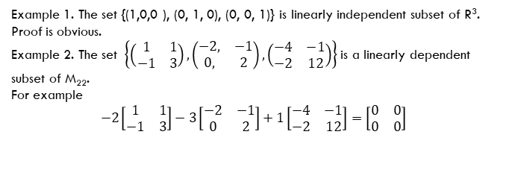
Linear Independence of Vectors (Same definitions with different way of stating)
Example 1. The set {(1,0,0 ), (0, 1, 0), (0, 0, 1)} is linearly independent subset of R³.
Proof is obvious.
Example 2. The set $\left\{\left(\begin{matrix}1 & 1 \\ −1 & 3\end{matrix}\right),\left(\begin{matrix}−2, & −1 \\ 0, & 2\end{matrix}\right),\left(\begin{matrix}−4 & −1 \\ −2 & 12\end{matrix}\right)\right\}$is a linearly dependent subset of M₂₂.
For example
$$−2\left[\begin{matrix}1 & 1 \\ −1 & 3\end{matrix}\right]−3\left[\begin{matrix}−2 & −1 \\ 0 & 2\end{matrix}\right]+1\left[\begin{matrix}−4 & −1 \\ −2 & 12\end{matrix}\right]=\left[\begin{matrix}0 & 0 \\ 0 & 0\end{matrix}\right]$$

Slide 31
Geometrical Meaning of Linear Independence and Dependence in R³

Slide 32
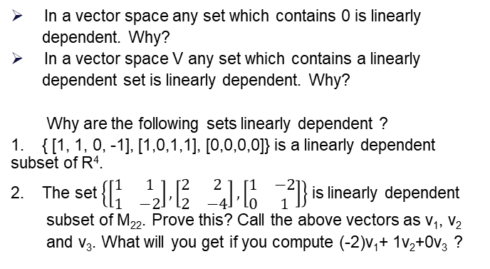
More Results on Linearly Dependent set
In a vector space any set which contains 0 is linearly
dependent. Why?
In a vector space V any set which contains a linearly
dependent set is linearly dependent. Why?
Why are the following sets linearly dependent ?
1. { [1, 1, 0, -1], [1,0,1,1], [0,0,0,0]} is a linearly dependent subset of R⁴.
2. The set $\left\{\left[\begin{matrix}1 & 1 \\ 1 & −2\end{matrix}\right], \left[\begin{matrix}2 & 2 \\ 2 & −4\end{matrix}\right], \left[\begin{matrix}1 & −2 \\ 0 & 1\end{matrix}\right]\right\}$is linearly dependent
subset of M₂₂. Prove this? Call the above vectors as v₁, v₂
and v₃. What will you get if you compute (-2)v₁+ 1v₂+0v₃ ?

Slide 33
What do the Linear dependence and independence mean in ML?
What does the concept of linear independence capture? If the vectors are linearly dependent we can write one of the vectors in terms of the others, so that vector is redundant. On the other hand, when the vectors are linearly independent, each vector brings something to the table which the other vectors collectively cannot replace.

Slide 34
Using Gaussian elimination to check for linear independence
A practical way of checking whether a bunch of vectors are linearly independent is to fill out the columns of a matrix with the given vectors and then perform Gaussian elimination to get the row-echelon form
The pivot columns indicate all the vectors that are linearly independent, and they are all on the left.
The non-pivot columns can be expressed as a linear combination of the pivot columns

Slide 35
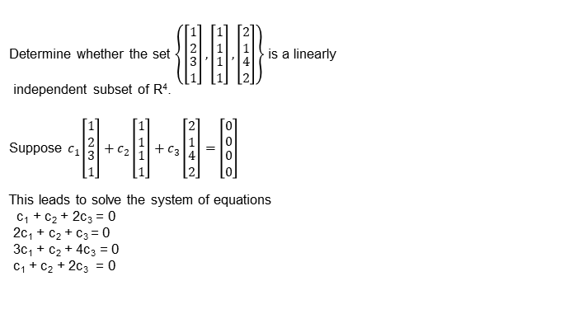
Example
Determine whether the set $\left\{\left[\begin{matrix}\begin{matrix}1 \\ 2\end{matrix} \\ \begin{matrix}3 \\ 1\end{matrix}\end{matrix}\right],\left[\begin{matrix}\begin{matrix}1 \\ 1\end{matrix} \\ \begin{matrix}1 \\ 1\end{matrix}\end{matrix}\right],\left[\begin{matrix}\begin{matrix}2 \\ 1\end{matrix} \\ \begin{matrix}4 \\ 2\end{matrix}\end{matrix}\right]\right\}$is a linearly
independent subset of R⁴.
Suppose $c_{1}\left[\begin{matrix}\begin{matrix}1 \\ 2\end{matrix} \\ \begin{matrix}3 \\ 1\end{matrix}\end{matrix}\right]+c_{2}\left[\begin{matrix}\begin{matrix}1 \\ 1\end{matrix} \\ \begin{matrix}1 \\ 1\end{matrix}\end{matrix}\right]+c_{3}\left[\begin{matrix}\begin{matrix}2 \\ 1\end{matrix} \\ \begin{matrix}4 \\ 2\end{matrix}\end{matrix}\right]=\left[\begin{matrix}\begin{matrix}0 \\ 0\end{matrix} \\ \begin{matrix}0 \\ 0\end{matrix}\end{matrix}\right]$
This leads to solve the system of equations
c₁ + c₂ + 2c₃ = 0
2c₁ + c₂ + c₃ = 0
3c₁ + c₂ + 4c₃ = 0
c₁ + c₂ + 2c₃ = 0

Slide 36
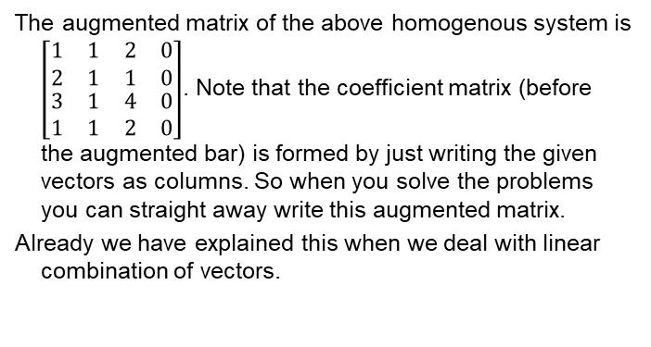
Example(Ctd)
The augmented matrix of the above homogenous system is $\left[\begin{matrix}\begin{matrix}1 & 1 \\ 2 & 1\end{matrix} & \begin{matrix}2 & 0 \\ 1 & 0\end{matrix} \\ \begin{matrix}3 & 1 \\ 1 & 1\end{matrix} & \begin{matrix}4 & 0 \\ 2 & 0\end{matrix}\end{matrix}\right]$. Note that the coefficient matrix (before the augmented bar) is formed by just writing the given vectors as columns. So when you solve the problems you can straight away write this augmented matrix.
Already we have explained this when we deal with linear combination of vectors.

Slide 37

Example(Ctd)
The echelon form of the augmented matrix is
$$\left[\begin{matrix}\begin{matrix}1 & 1 \\ 0 & −1\end{matrix} & \begin{matrix}2 & 0 \\ −3 & 0\end{matrix} \\ \begin{matrix}0 & 0 \\ 0 & 0\end{matrix} & \begin{matrix}3 & 0 \\ 0 & 0\end{matrix}\end{matrix}\right]$$
Verify.
Since every column (before the augmented bar) has pivot element the system of equations has only a trivial solution namely c₁ = 0, c₂ = 0, and c₃ = 0. Therefore the given vectors are linearly independent.

Slide 38
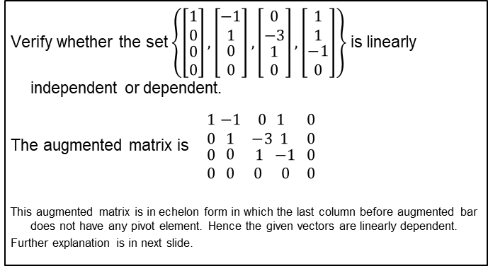
Example
Verify whether the set $\left\{\left[\begin{matrix}\begin{matrix}1 \\ 0\end{matrix} \\ \begin{matrix}0 \\ 0\end{matrix}\end{matrix}\right],\left[\begin{matrix}\begin{matrix}−1 \\ 1\end{matrix} \\ \begin{matrix}0 \\ 0\end{matrix}\end{matrix}\right],\left[\begin{matrix}\begin{matrix}0 \\ −3\end{matrix} \\ \begin{matrix}1 \\ 0\end{matrix}\end{matrix}\right],\left[\begin{matrix}\begin{matrix}1 \\ 1\end{matrix} \\ \begin{matrix}−1 \\ 0\end{matrix}\end{matrix}\right]\right\}$ is linearly independent or dependent.
The augmented matrix is$\begin{matrix}\begin{matrix}1 \\ 0\end{matrix} \\ \begin{matrix}0 \\ 0\end{matrix}\end{matrix}$ $\begin{matrix}\begin{matrix}−1 \\ 1\end{matrix} \\ \begin{matrix}0 \\ 0\end{matrix}\end{matrix} \begin{matrix}\begin{matrix}0 \\ −3\end{matrix}\begin{matrix}1 \\ 1\end{matrix} \\ \begin{matrix} 1 \\ 0\end{matrix}\begin{matrix} −1 \\ 0\end{matrix}\end{matrix} \begin{matrix}\begin{matrix}0 \\ 0\end{matrix} \\ \begin{matrix}0 \\ 0\end{matrix}\end{matrix}$
This augmented matrix is in echelon form in which the last column before augmented bar does not have any pivot element. Hence the given vectors are linearly dependent.
Further explanation is in next slide.

Slide 39
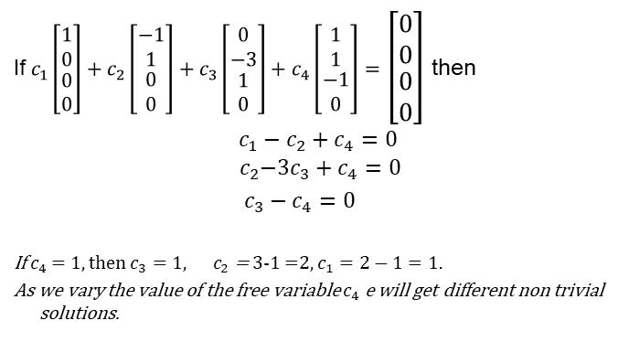
Example Ctd
If $c_{1}\left[\begin{matrix}\begin{matrix}1 \\ 0\end{matrix} \\ \begin{matrix}0 \\ 0\end{matrix}\end{matrix}\right]+c_{2}\left[\begin{matrix}\begin{matrix}−1 \\ 1\end{matrix} \\ \begin{matrix}0 \\ 0\end{matrix}\end{matrix}\right]+c_{3}\left[\begin{matrix}\begin{matrix}0 \\ −3\end{matrix} \\ \begin{matrix}1 \\ 0\end{matrix}\end{matrix}\right]+c_{4}\left[\begin{matrix}\begin{matrix}1 \\ 1\end{matrix} \\ \begin{matrix}−1 \\ 0\end{matrix}\end{matrix}\right]=$ $\left[\begin{matrix}\begin{matrix}0 \\ 0\end{matrix} \\ \begin{matrix}0 \\ 0\end{matrix}\end{matrix}\right]$ then
$$c_{1}−c_{2}+c_{4}=0$$
$${ c}_{2}−{3c}_{3}+c_{4}=0$$
$c_{3}−c_{4}=0$
If $c_{4}$ = 1, then $c_{3}=1, { c}_{2}$ = 3-1 =2, $c_{1}=2−1=1.$
As we vary the value of the free variable $c_{4}$ e will get different non trivial solutions.

Slide 40
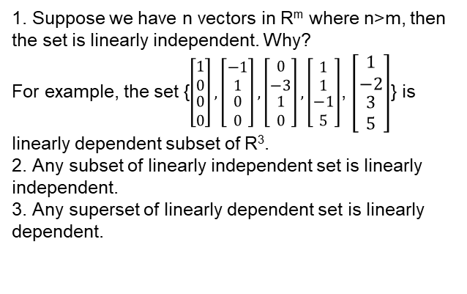
Quick way of identifying a linearly (in)dependent set
1. Suppose we have n vectors in R^{m} where n>m, then the set is linearly independent. Why?
For example, the set {$\left[\begin{matrix}\begin{matrix}1 \\ 0\end{matrix} \\ \begin{matrix}0 \\ 0\end{matrix}\end{matrix}\right],\left[\begin{matrix}\begin{matrix}−1 \\ 1\end{matrix} \\ \begin{matrix}0 \\ 0\end{matrix}\end{matrix}\right],\left[\begin{matrix}\begin{matrix}0 \\ −3\end{matrix} \\ \begin{matrix}1 \\ 0\end{matrix}\end{matrix}\right],\left[\begin{matrix}\begin{matrix}1 \\ 1\end{matrix} \\ \begin{matrix}−1 \\ 5\end{matrix}\end{matrix}\right]$, $\left[\begin{matrix}\begin{matrix}1 \\ −2\end{matrix} \\ \begin{matrix}3 \\ 5\end{matrix}\end{matrix}\right]$} is linearly dependent subset of R³.
2. Any subset of linearly independent set is linearly independent.
3. Any superset of linearly dependent set is linearly dependent.

Slide 41
Basis of vector space
Does there exist a set of vectors in a vector space which ”span” the entire space?
What we mean here is that any vector v ∈ V can be generated as a linear combination of the vectors in question.
Is such a set of vectors unique to the vector space?
Are all sets capable of generating all vectors in a vector space of the same size?

Slide 42
Generating set and basis
Consider a vector space V = (V, +, .) and a set of vectors
A = {x₁, x₂, . . . x_{k} } ⊆ V .
If every vector v ∈ V can be expressed as a linear combination of the vectors x₁, x₂, . . . x_{k} , then A is called a generating set of V.
The set of all linear combinations of the vectors in A is known as the span of A.
If A spans the vector space V we write V = span[A].

Slide 43
Basis as smallest generating set
Consider a vector space V = (V, +, .) and A ⊆ V.
A generating set A of V is called minimal if there is no smaller set A˜ such that A˜ ⊂ A ⊆ V that spans V .
Every linearly independent generating set of V is minimal and is called a basis of V .

Slide 44
Basis and Dimension of a Vector Space
Definition of a Basis : A finite set of {v₁, v₂, … v_{n}} is called basis of a vector space V if {v₁, v₂, … v_{n}} is a linearly independent subset of V and {v₁, v₂, … v_{n}} spans V.
{ (0, 0, 0, 1), (0,1,1,0), (1,1,0,0) }is a linearly independent subset of R⁴ but not s basis of R⁴ since it does not span R⁴.
{ (1, 0, 0, 0), (0,1,0,0), (0,0,1,0), (0,0,0,1) }is a linearly independent subset of R⁴ and spans R⁴ and hence it is a basis of R⁴. This basis is called standard basis of R⁴.
Write standard basis of R^{n}, M_{mn.}
Definition : The number of elements of a Basis of vector space is called dimension of the vector space.

Slide 45
Dimension of a Vector Space
Example 1 : Dimension of R⁴ is 4. Since {(1,0,0,0), (0,1,0,0), (0,0,1,0), (0,0,0,1)} is a basis of R⁴. (Standard Basis).
Example 2 : Dimension of R^{n} is n, since the standard basis contains n elements.
Example 3 : Dimension of M₂₂ is 4, since the standard basis of M₂₂ = $\left\{\left[\begin{matrix}1 & 0 \\ 0 & 0\end{matrix}\right],\left[\begin{matrix}0 & 1 \\ 0 & 0\end{matrix}\right],\left[\begin{matrix}0 & 0 \\ 1 & 0\end{matrix}\right],\left[\begin{matrix}0 & 0 \\ 0 & 1\end{matrix}\right]\right\}$ contains 4 elements.
Example 4 : Dimension of M₃₂ is 6, since the standard basis
of M₃₂ = $\{\left[\begin{matrix}1 & 0 \\ 0 & 0 \\ 0 & 0\end{matrix}\right]$, $\left[\begin{matrix}0 & 1 \\ 0 & 0 \\ 0 & 0\end{matrix}\right]$, $\left[\begin{matrix}0 & 0 \\ 1 & 0 \\ 0 & 0\end{matrix}\right]$, $\left[\begin{matrix}0 & 0 \\ 0 & 1 \\ 0 & 0\end{matrix}\right]$, $\left[\begin{matrix}0 & 0 \\ 0 & 0 \\ 1 & 0\end{matrix}\right]$, $\left[\begin{matrix}0 & 0 \\ 0 & 0 \\ 0 & 1\end{matrix}\right]\}$ contains 6 elements.

Slide 46
Dimension of a Vector Space

Slide 47
Examples

Slide 48
Dimension of a vector space
Is the size of the basis merely the number of components in the vector?
So far, that has been the case.
But consider the vector space span( ⁰ ) - the vector has two
1
components, but the basis is just one vector. All vectors in
0 .
this vector space are multiples of the vector
1

Slide 49
Finding a basis
There are three steps to finding a basis for a vector space. A basis of a subspace U = span(x₁, . . . , x_{m}) ⊆ R^{n} can be found by executing the following steps:
Write the spanning vectors as columns of a matrix A.
Determine the row-echelon form of A.
The spanning vectors associated with the pivot columns are a basis of U.

Slide 50
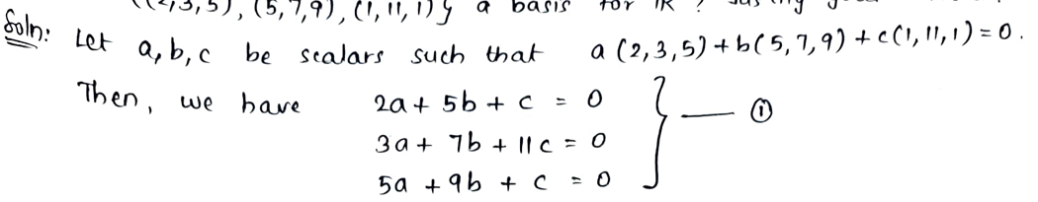
Basis and Dimension Example
One important point about Basis and Dimension:
If we already know the dimension of a vector space V as n and if a linearly independent subset ov V contains n elements then it must be a basis. Because basis is the minimal linearly independent set.
This fact is used when we solve the following problem:

Slide 51
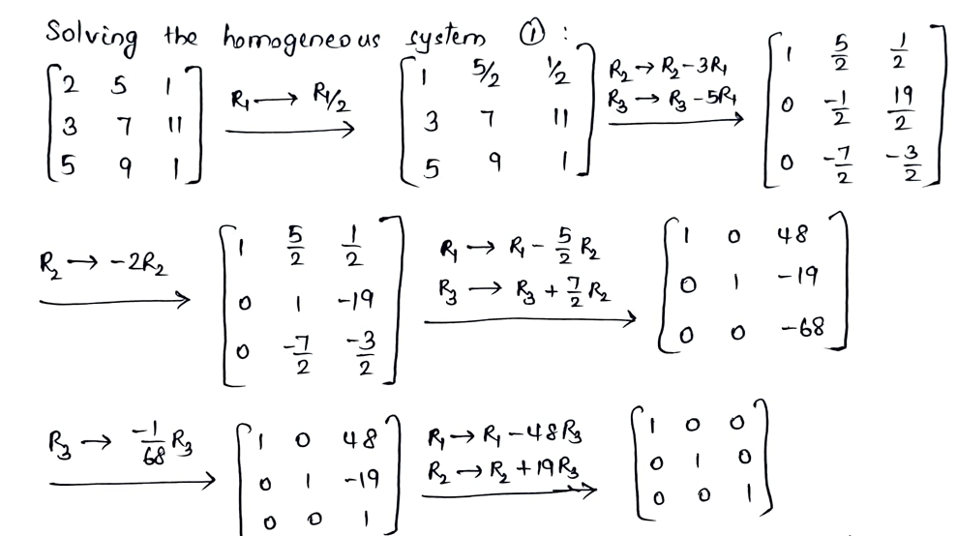
Example ctd

Slide 52
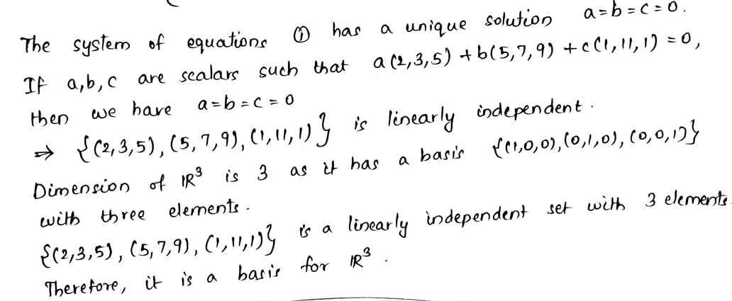
Example ctd

